Slide 1
Inventory Management for Small Car Dealerships
By: Dawson Daniel and Jefte Ntekwa

Slide 2
Our Main Goal
To create a web-based software for used car dealerships.
To use our knowledge of data management to create a database using XAMPP where we will store all the records.
Combine the XAMPP database to the website using PHP to make a professional website.
The website will be small and easy to use. We used our knowledge of HTML for the markup of the website, CSS to style the website, PHP to combine the website to the database in order to make a professional website and JavaScript for validations of HTML forms.

Slide 3
Project Description
Name of the software: J&D Motor
IDE: XAMPP Database and Visual Studio Code
Since it’s a business software, before accessing the website, there is a login page at first. If the user is new, there is a signup link at the bottom of the login form that leads you to the signin page.
After the user login, then have full access to whole website. The user have the privilege to access their record in the database, add new record to the database, and delete records to the database.
The user can’t manually access the XAMPP database.

Slide 4
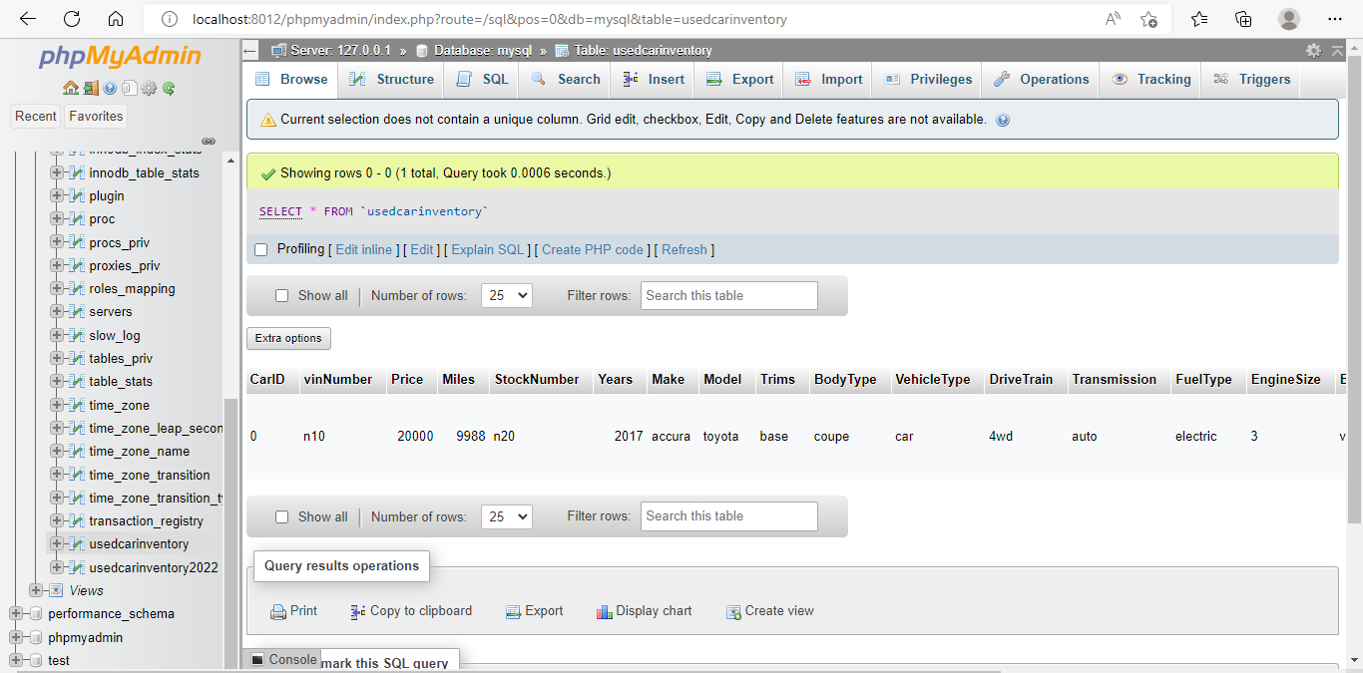
Xampp Database

Slide 5
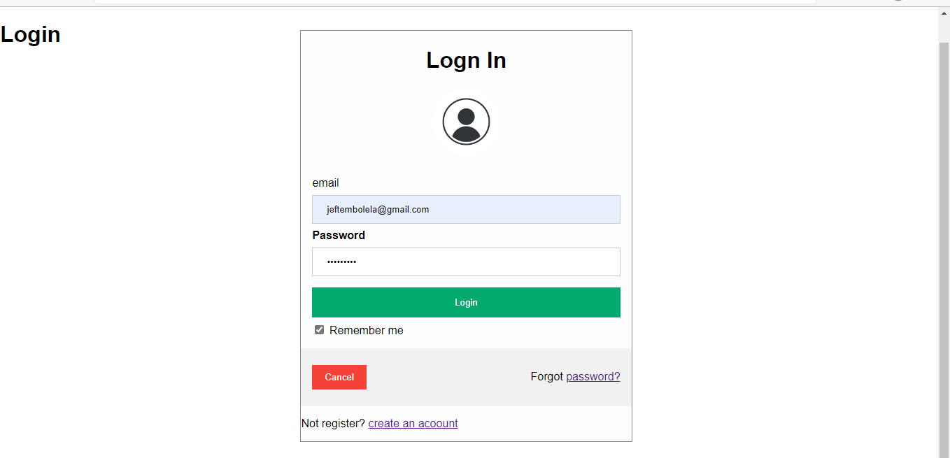
Login page

Slide 6
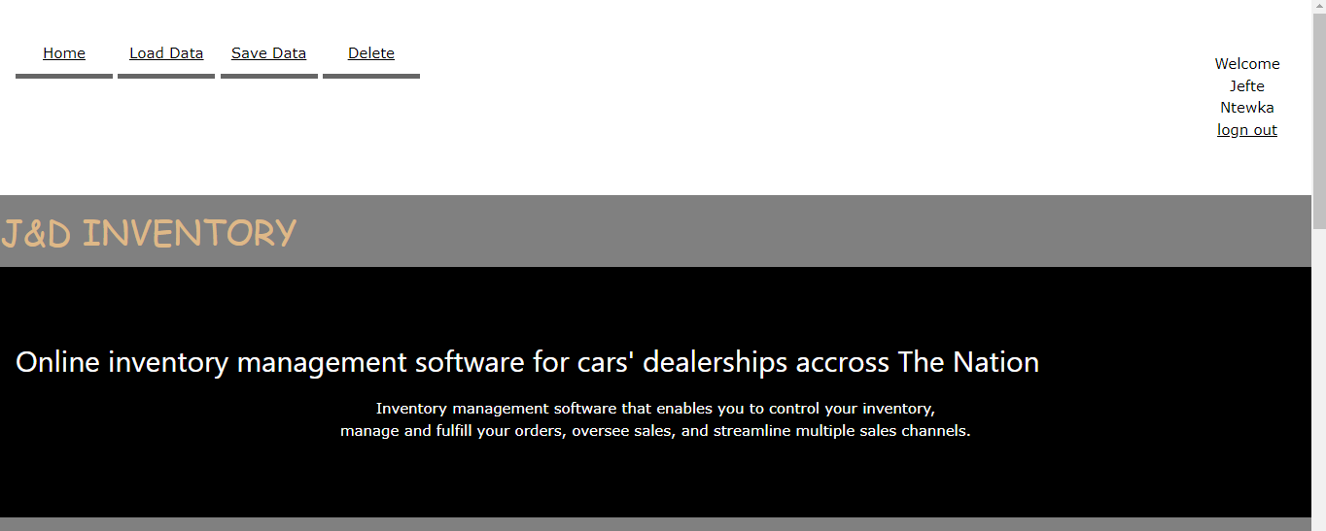
Top of main page

Slide 7
Importance
Makes the lives of salesmen easier
Increases the efficiency of managing their lot
Takes the strain off of the salesmen
Allows easy access to information about a specific car

Slide 8
Potential Future Work
To add an automatic price prediction feature
Swap to a cloud based database to increase the usability of our software
Add the option to include a picture/pictures of a car when adding to the database
Add the ability to purchase a car off of the website
Possibly buy the domain of it

